Slide 1
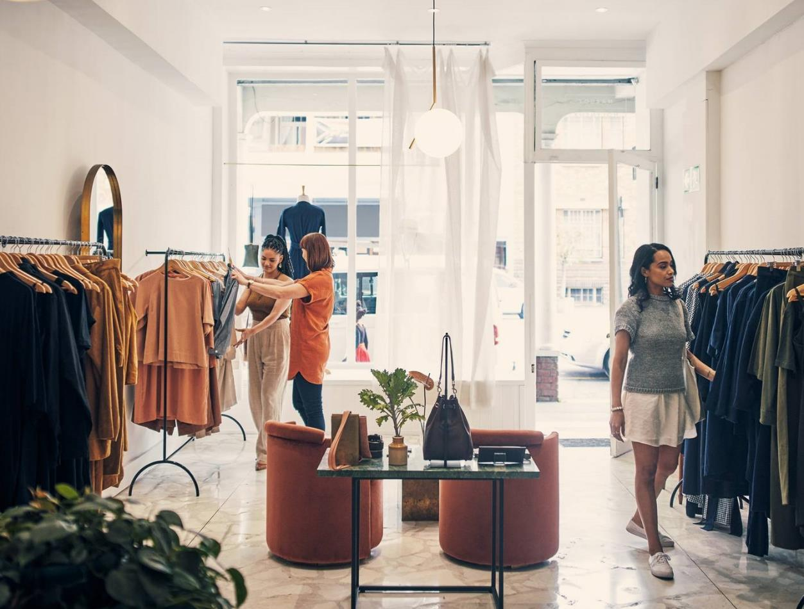
H & M (Hennes & Mauritz )
Business Objective – Strategy – Tactics – KPIs - Targets – Segments –
Sohini Chintala

Slide 2
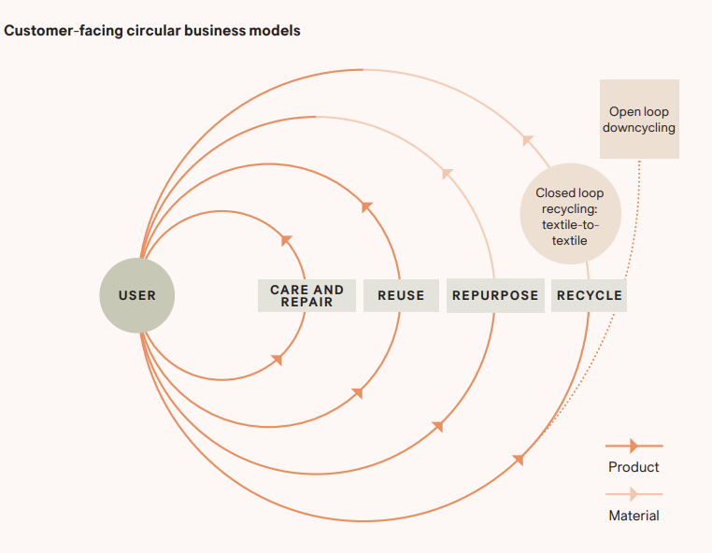
About H&M
Hennes & Mauritz | Fashion, Homeware, & Kids |
H&M is a global fashion design company that has over 4,000 stores in 75 countries and sells online in over 65 markets.
H&M group includes various brands and businesses that share the same commitment to making sustainable fashion and design accessible to all. Each brand has its own distinct personality, and together they complement and reinforce the H&M Group, enabling a more circular lifestyle.
Notes:
H&M is a global company with multiple brands in it. It strictly follows on making sustainable fashion and focuses primarily on reducing GHG emissions by 50% in the next few years. It follows a circular business model that enables a product to circulate many times between users or customers.

Slide 3

Problem Statement
Business Objectives
Business Model
Business Purpose
Business Goals
Strategies
Tactics
Key Performance Indicators (KPI)
Targets
Segments
Notes:
Here is the given Problem Statement where we will be identifying the business objectives (models and purpose), business goals (strategies and tactics), KPIs, Targets and finally, segments for each KPI.

Slide 4




Business Objective
H&M’s primary goals most likely include improving sales and market share, expanding its client base, and boosting brand loyalty while maintaining sustainability.
Marketing Goal: H&M is expected to focus on both immediate sales and long-term client relationships, trying to find a balance between boosting revenue and creating brand loyalty.
Expansion
Customer Engagement
Profitability
Sustainability
Increase their global presence through new store openings and online sales, which will in turn improve company’s market share.
Deepen customer relationships and attract new audiences across target age groups through tailored marketing and digital innovation.
Circular Customer Business Model
Increase revenues and margins through efficient operations and strategic pricing.
Increase sustainability efforts in sourcing, manufacturing, and operations, and reduce GHG Emissions further.
Notes:
The company’s objective is to improve its sales and maintain customer relationships while increasing efforts for sustainability. The company focuses on circular customer business model that enables a product to circulate many times between users or customers.. A product may be repaired, reused as a product, reused as materials and remade into a new product, or recycled.

Slide 5
Business Model
The company's operating model emphasizes on providing affordable yet fashionable apparel and accessories to an extensive range of consumers globally through a mix of online and offline channels. The company has short production cycles and high inventory turnover, which allows them to adapt quickly to the trends in the market. H&M leverages social media marketing through paid and organic traffic to showcase the latest trends and collections through influencer collaborations or user-generated content campaigns.
Organic Traffic is targeted and cost-effective, whereas paid advertising offers faster results and allows for precise targeting. H&M uses organic traffic by optimizing its online presence for search engines, generating content about fashion and sustainability, and engaging with its audience on social media channels. Furthermore, H&M employs SEO tactics to ensure that its products and efforts are easily discovered by prospective buyers searching for fashion-related topics online. This helps to boost brand visibility, and consumer engagement.
Paid traffic plays a crucial role in promoting specific products, or limited-time deals to a targeted audience, driving immediate sales and conversions. Each traffic source plays a role in the customer journey, and understanding particular business objectives can help in finding the most effective combination. Measurability is crucial for any traffic source. This traffic can be effectively measured to track conversions, user behavior, and campaign performance.
Notes:
Overall, the company’s business motive is to provide affordable yet fashionable clothing with extensive focus on sustainability. Both the traffics are equally important to the company and can be effectively measured to track online sales data.

Slide 6
Business Purpose
Hennes & Mauritz | Fashion, Homeware, & Kids |
The company’s purpose is to make fashion more accessible to everyone in a sustainable way. It seeks to support a circular fashion industry with net-zero climate impact across their value chain by 2040. H&M attempts to stay ahead of competitive trends, maintain sustainability initiatives, and provide customers with an interesting and simple shopping experience. H&M also intends to have a net-positive impact on biodiversity, eco-friendly practices throughout the supply chains, and customer journeys.

Slide 7
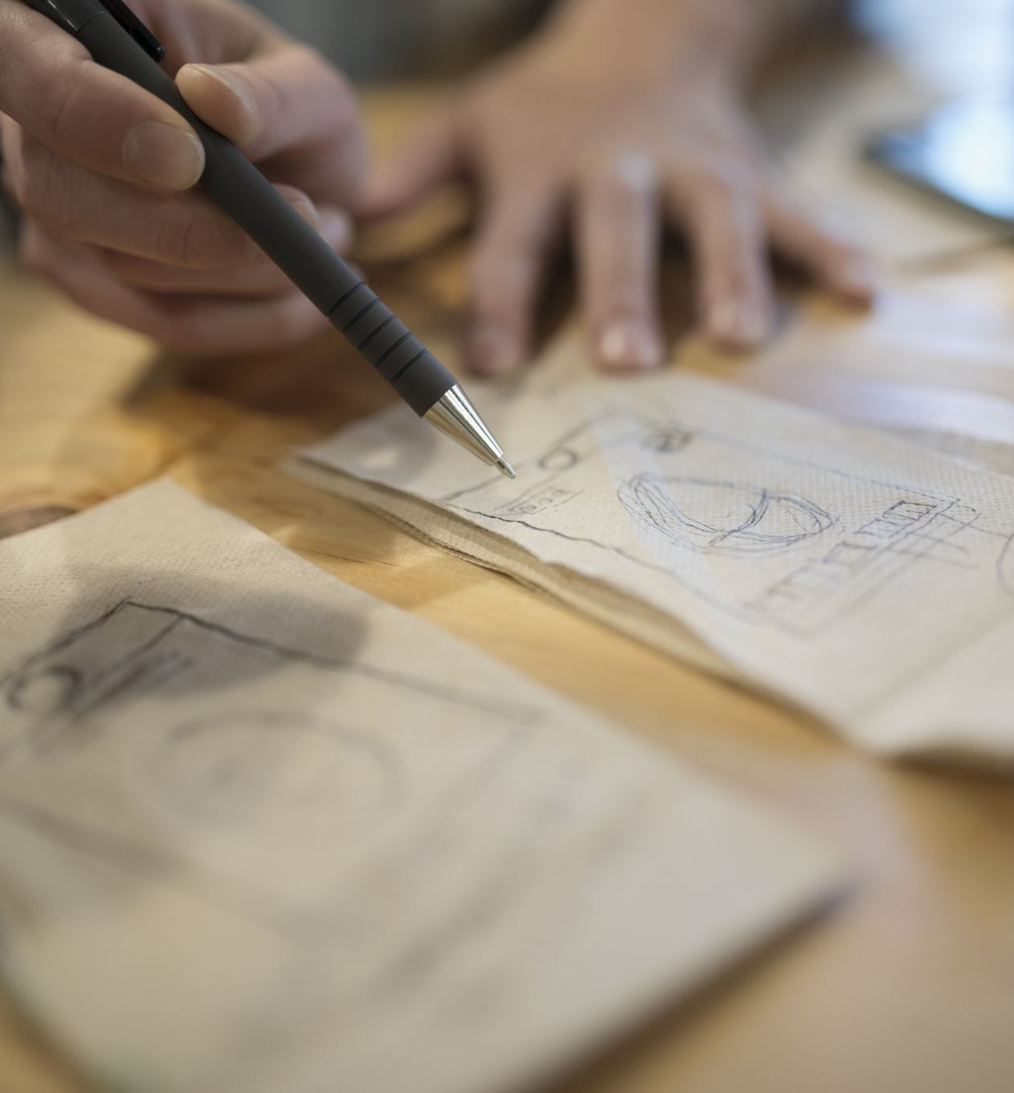
Strategy
1.
Rapidly changing Trends/ Fashion: H&M's fundamental business model is to adapt swiftly to fashion trends and client expectations with affordable, trendy apparel and accessories. H&M is able to offer new products at affordable pricing by focusing on effective supply chain management, design, and production.
2.
Sustainability: The company focuses on implementing sustainable methods within its operations, such as sustainably procuring products, and encouraging recycling efforts. H&M wants to promote transparency and it invests in new technology, and business models to revolutionize the way it produces its products.
3.
Global Expansion: The company continues to increase its global footprint by opening new stores in key locations and expanding their online sales platforms. H&M owns outlets in various geographical locations all over the world.
4.
Customer Engagement: The company focuses on customer engagement through tailored advertising, digital innovation, and a better shopping experience, both in-store and online.
Notes:
Some of the strategies the company follows or focuses on to achieve its market objectives are
Rapidly changing to the trends – following fashion trends | Improving sustainability further | Expanding its reach | Tailored Advertising for better shopping experience | Outsourcing Operations | Making quality fashion affordable

Slide 8

Strategy
5.
Operations: The company optimizes its operations by outsourcing to increase efficiency, lower costs, and maintain competitive pricing. It outsources non-essential operations so that it can focus on its primary business model. For example: H&M purchases clothing and other accessories from a wide range of suppliers.
6.
Price and Promotion: H&M focuses on satisfying customers' requirements with clothes at a low price by managing shipping and labor costs to the extent practicable. H&M created a promotion plan that included advertising, sales promotion, and online promotion, which helped the company gain global exposure.
Notes:
Some of the strategies the company follows or focuses on to achieve its market objectives are
Rapidly changing to the trends – following fashion trends | Improving sustainability further | Expanding its reach | Tailored Advertising for better shopping experience | Outsourcing Operations | Making quality fashion affordable

Slide 9
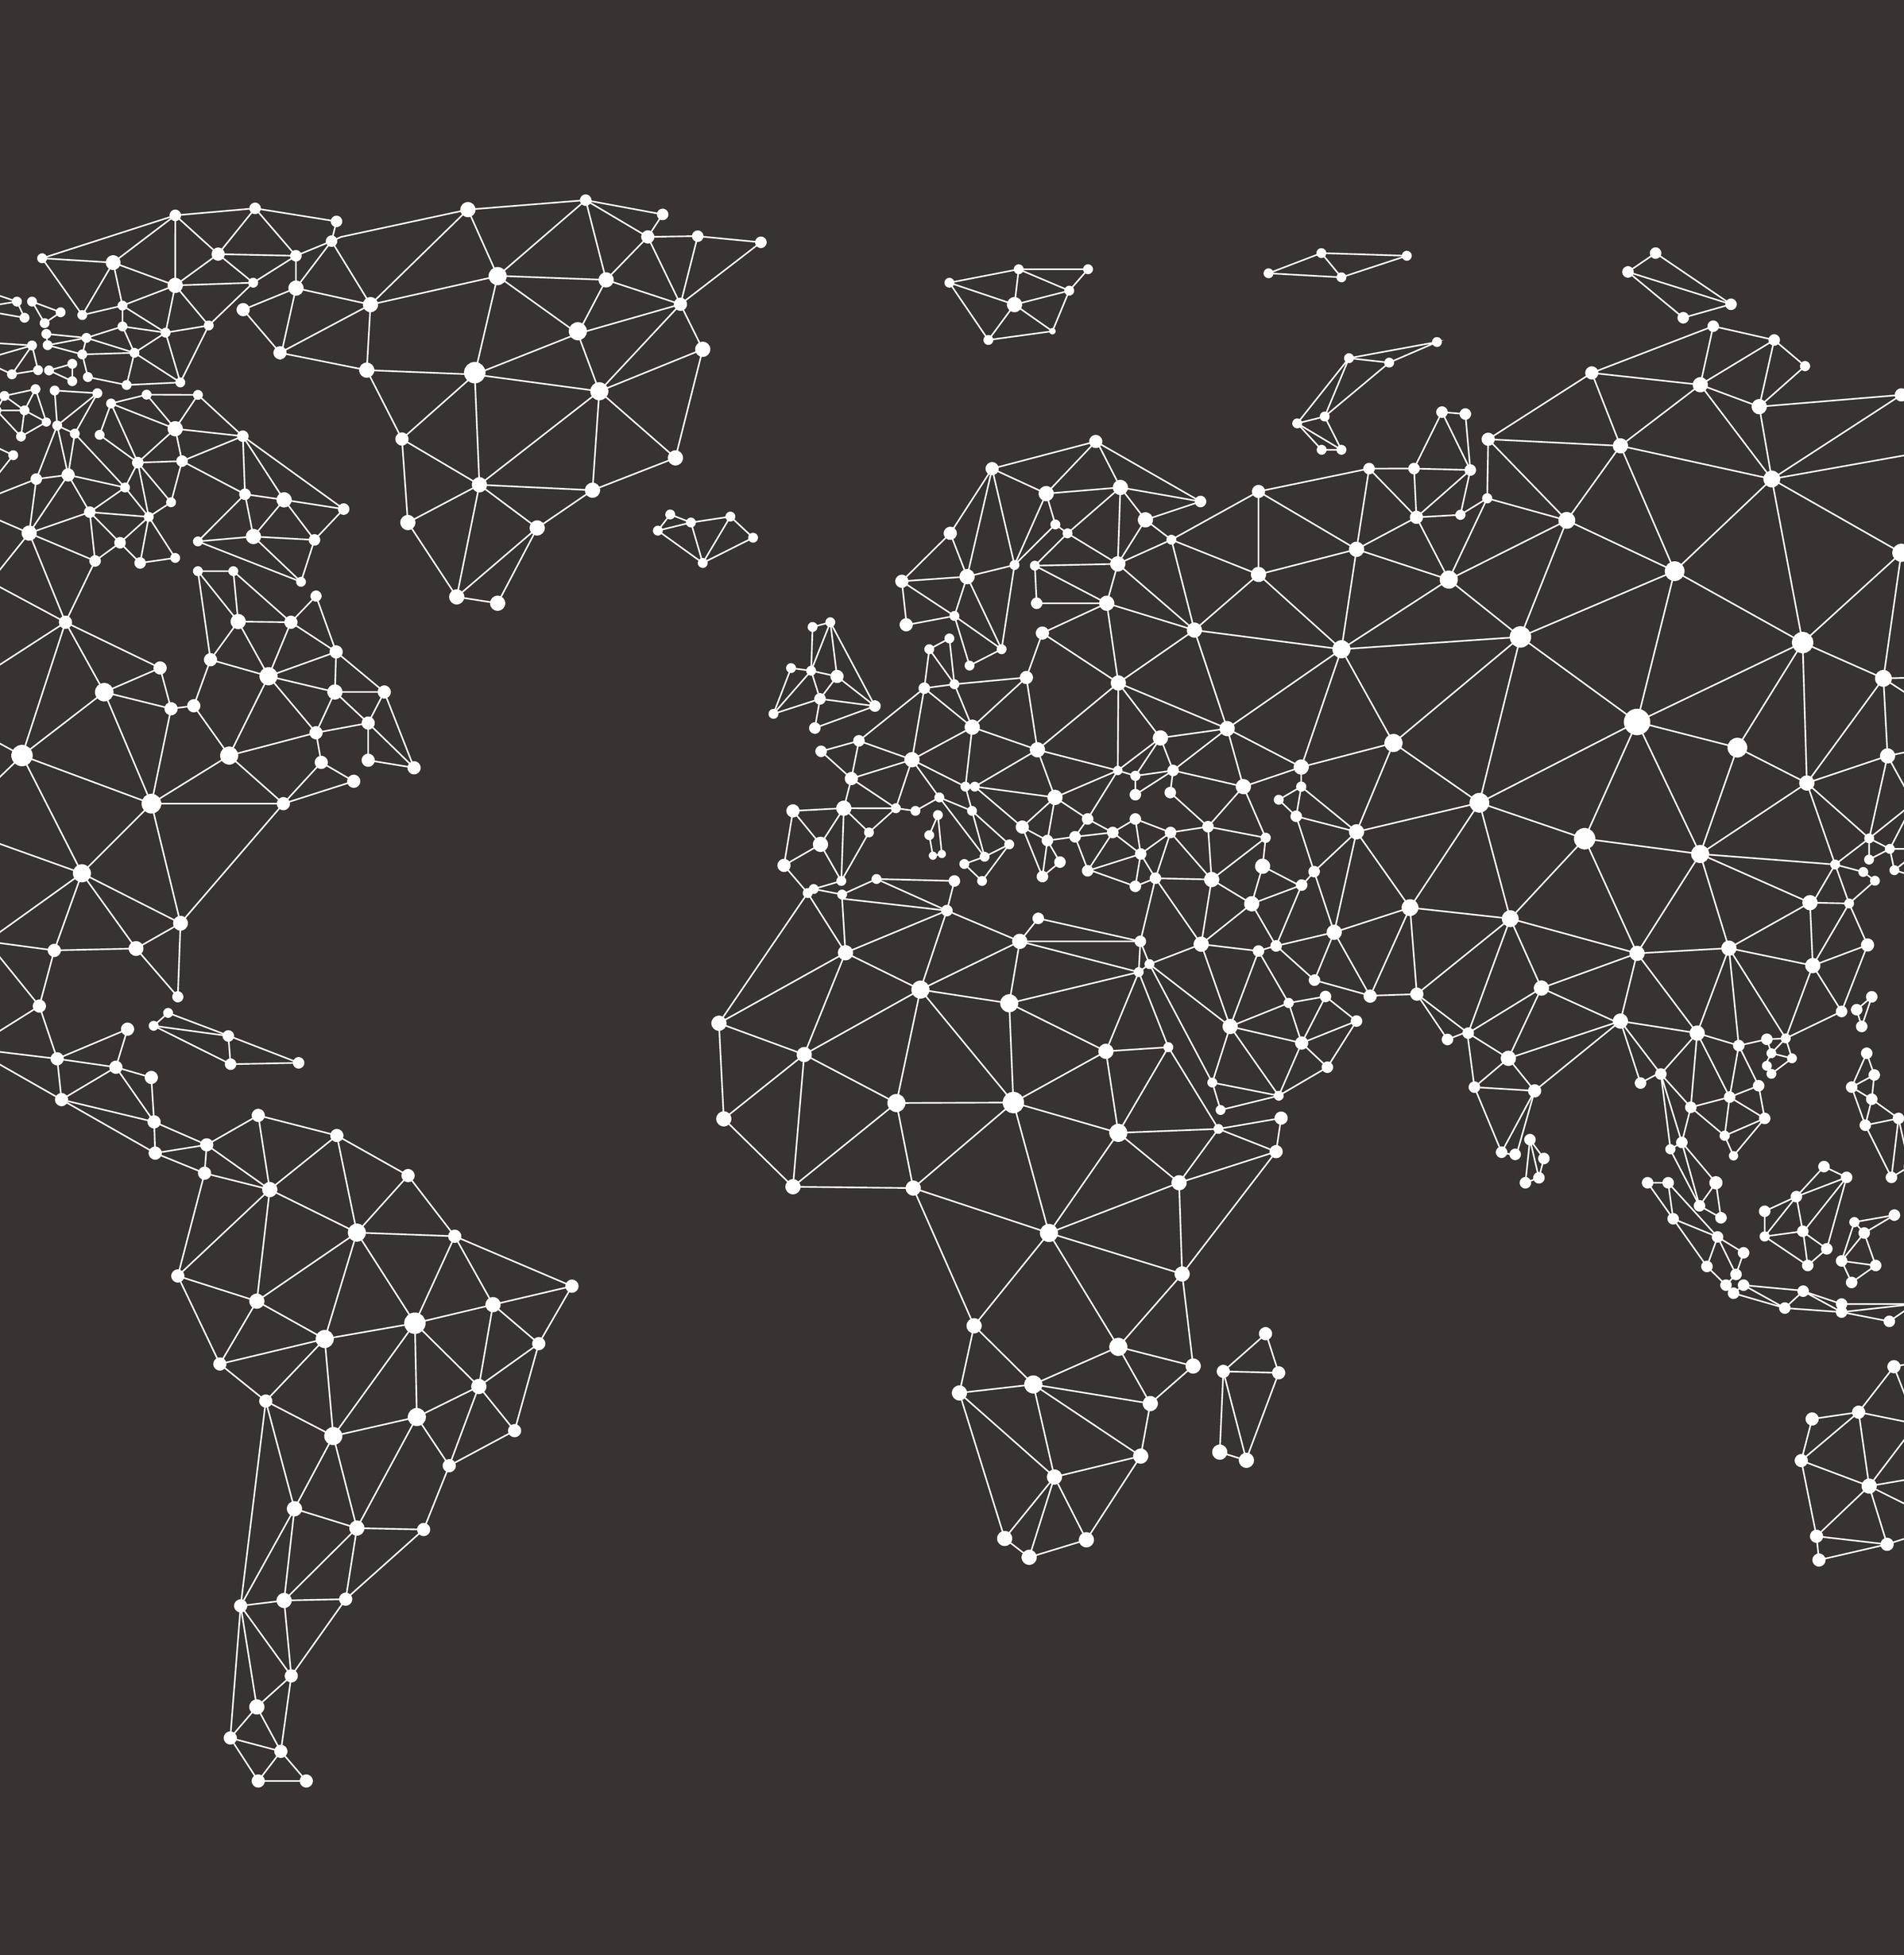
Digital Channel
Hennes & Mauritz | Fashion, Homeware, & Kids |
H&M directs viewers to visit its website through various channels, including digital platforms, social media, and print media to shop online. The company collaborates with influencers, celebrities, and fashion bloggers to promote its brand and products to their followers. These influencers often feature H&M clothing in their posts, tag the brand, and provide links to the website, encouraging their audience to explore and shop the latest collections.
The company's website is optimized for search engines to ensure high visibility in search engine results pages (SERPs) for relevant keywords such as "new trends," "offers" or "flash sale". This allows the company to attract individuals who are actively searching for relevant content and products. H&M also utilizes email marketing campaigns to communicate with its existing customer base and subscribers, to send updates on new arrivals, promotions, and exclusive offers, driving recipients to visit the H&M website to browse and shop.
Notes:
The company uses different channels to market. It involves social media where they collaborate with influencers and designers. The website is also optimized in such a way that keywords show up using SEO.

Slide 10
Tactics Implemented
Brand Reach and Value
Sales Performance
Omni Channel Analytics
Influencer Marketing
Social Media Engagement
Sustainability Measures
Customer Satisfaction – Circular Customer Journey

Slide 11
Tactics
Sustainability Measures
Brand Reach and Influence
The company collaborates with fashion marketing companies to increase the brand's reach and influence. H&M can conduct surveys to assess brand awareness, reputation, and customer loyalty throughout its target audiences.
Sales Performance
H&M may analyze overall business performance by tracking sales parameters such as revenue, profit margins, and same-store sales growth, and continuously track its performance both in stores and online. The company can access its financial reports and key performance indicators (KPIs) to track progress toward financial targets and goals.
The company might be conducting regular surveys to assess customer satisfaction and receive feedback on products, services, and purchasing experiences.
As the company uses social media for most of its digital marketing, it can track metrics such as likes, shares, and comments to evaluate brand engagement and reaction among customers on platforms such as Facebook and Instagram.
Social Media Engagement
Customer Satisfaction Surveys
Designer Collaborations with recognized designers, celebrities, and brand ambassadors to promote products and create limited edition collections are expected to engage target audiences on social media.
Influencer Marketing
To track progress toward sustainability targets, the organization can report key sustainability indicators such as carbon emissions, water usage, and waste reduction. It can launch recycling programs to encourage customers to donate clothing they no longer use for reuse or recycling, and also include environmentally friendly practices into its operations, such as energy-efficient lighting and recycled materials.
Notes:
These are the tactics implemented by the company to achieve its goals/objectives.

Slide 12
Key Performance Indicators (KPI)
Sales Revenue
Gross Profit Margin
Online Sales Growth
Average CoGS
Spends across Channels
Return on Ad Spend (ROAS)
Inventory Turnover Ratio
Sustainability Measures
Customer Lifetime Value (CLV)

Slide 13
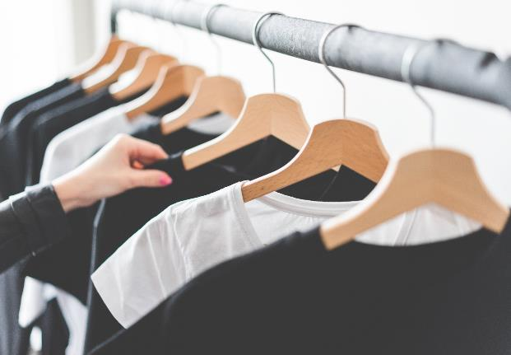

Current Key Figures
30% 22% from 2019
Around 30% online sales as a share of the group’s net total
22% reduction in scope 3 greenhouse gas (GHG) emissions under the company’s target against a 2019 baseline.
SEK 13B
85% Recycled
13 billion SEK profit after financial items
85% recycled or sustainably sourced materials in company’s commercial goods, including 25% recycled materials
SEK 34 B
SEK 236 B
34 billion SEK in cash flow from operating activities
SEK 236 billion in net sales, +6% vs. 2022

Slide 14
KPI Targets (Typical Targets and Benchmarks)
Sales Revenue
Minimum of 7% year-on-year growth in Sales
Gross Profit Margin
Maintain a gross margin of at least 50-55%
Online Sales Growth
Target 10-15% growth in online sales
Customer Lifetime Value (CLV)
Improve customer lifetime value by 5% yearly
Sustainability Measures
Improve recycled materials to 50% and achieve a 55% reduction in GHG Emissions within the next 5 years.
CoGS
Increase the average spend of a customer by atleast 5%
Return on Ad Spend (ROAS)
The company can aim for 2 times return on advertising.

Slide 15



Segments
Product Category
Geography
Customer Lifecycle
Marketing Channel
Customer Type
Clothing
Footwear
Cosmetics
Homeware
Accessories
Asia and Oceania
Europe and Africa
North and South America
New Customers
Repeating Customers
Lapsed Customers
Traffic Source (organic search, paid search, social media, email marketing, and direct traffic)
Referral Source (social media, affiliate websites, or customer referrals)
Device Type (desktop, mobile, tablet)
Demographic (age, gender, income)
Psychographic (Based on lifestyle, attitudes, interests, and personality traits)
Notes:
Marketing Channel - | Traffic Source (organic search, paid search, social media, email marketing, and direct traffic) | Referral Source (social media, affiliate websites, or customer referrals) | Device Type (desktop, mobile, tablet) |
Customer Type - | Demographic (age, gender, income) | Psychographic (Based on lifestyle, attitudes, interests, and personality traits) |

Slide 16
Thank you
Business Objective – Strategy – Tactics – KPIs - Targets – Segments –
Sohini Chintala
schintala@umass.edu

